Slide 1
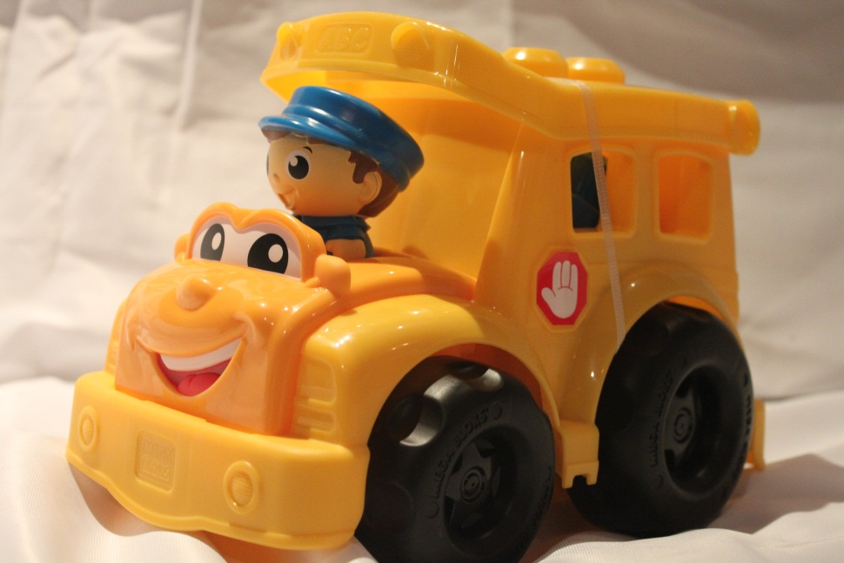
Naidovi Primary School - Kindergarten
Toy Catalogue
July 2012

Slide 2

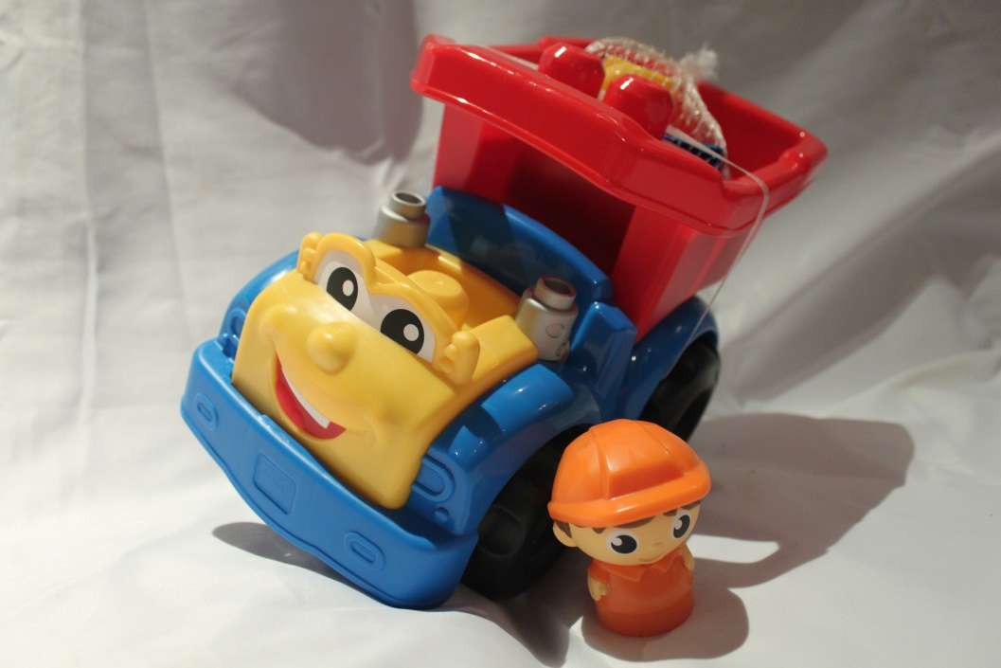
NPS-K1
Mega Blocks –
Dylan Dump Truck – Blue & Red
Contains - Truck, Driver, 2 blue blocks, 2 yellow block3
Ages -1-5
NPS – K1
NPS-K2
NPS-K2
Mega Blocks - Sonny School Bus – Yellow
Contains - Bus, Driver, 2 blue blocks, 1 red block
Ages -1-5
NPS-K2
Naidovi Primary School – Kindergarten. July, 2012

Slide 3
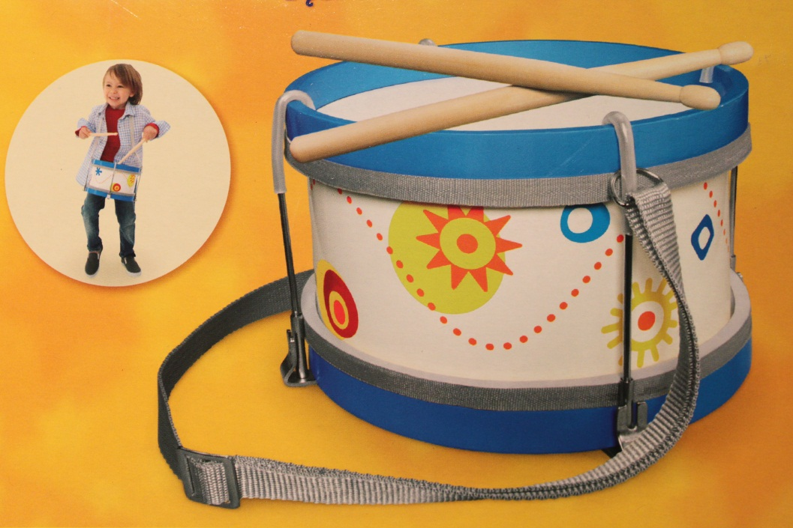
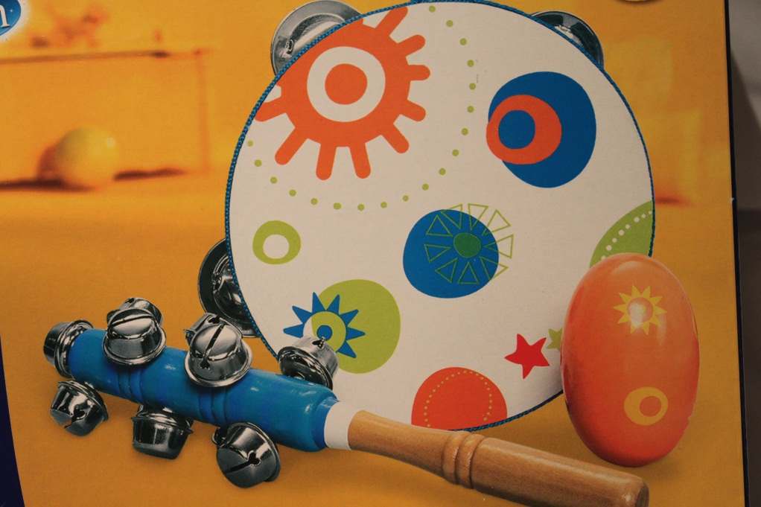
NPS-K3
Universe of Imagination
Marching Drum
Contents – 1 Drum, 2 Drum Sticks
NPS-K3
NPS-K4
NPS –K4
Universe of Imagination
3 Piece Shake It Up Music Set
Contents - 1 Bell Stick, 1 Egg Shaker &
1 Tambourine
Naidovi Primary School – Kindergarten – July 2012

Slide 4
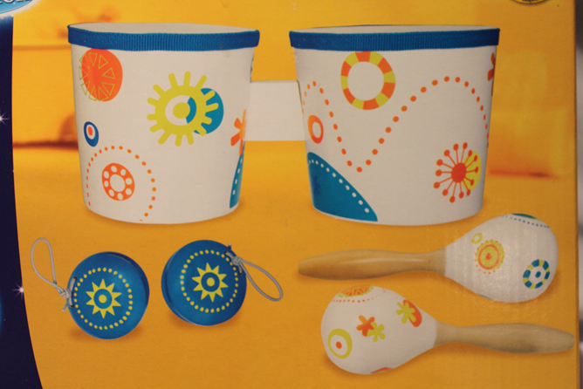
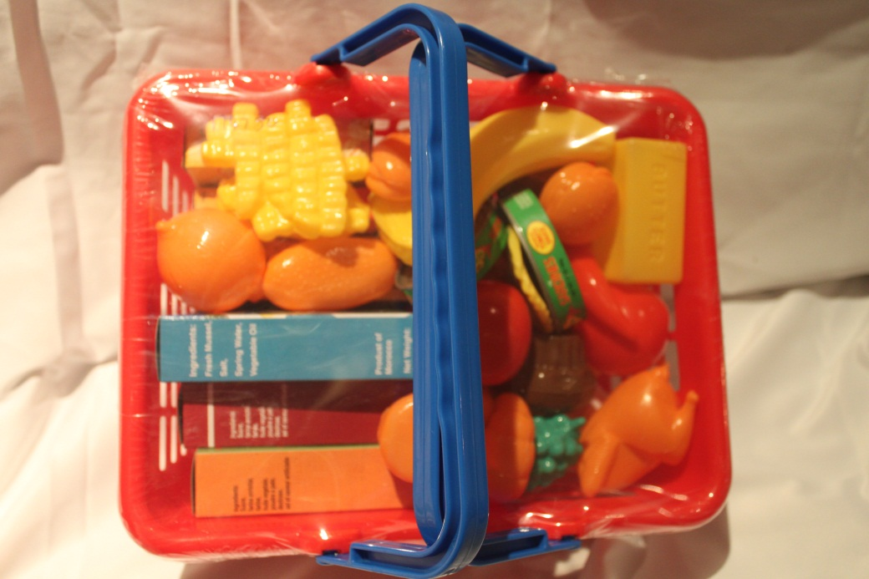
NPS-K5
Universe of Imagination
Bongo Set
Contains – 2 Maracas, @ Castenets & 2 Bongos
Ages -3+
NPS-K5
NPS-K6
Red Shopping Basket
Contains – Basket, Assorted plastic fruit and vegetables, cans and packets
Ages – 2-5
NPS-K6
Naidovi Primary School – Kindergarten – July 2012

Slide 5
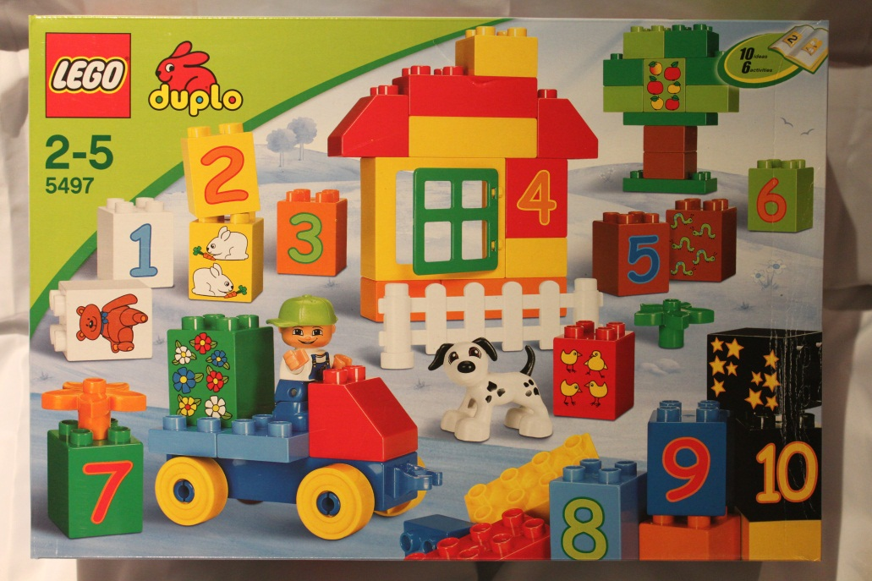

NPS-K7
NPS –K7
Lego Duplo Blocks 4597
Ideas and Activities – Counting Numbers.
Fine Motor Skills.
Shapes and Colours.
Ages -2 – 5 Years
Contains -58 pieces
NPS-K8
Lego Duplo Blocks 4597
Ideas and Activities – Counting Numbers.
Fine Motor Skills.
Shapes and Colours.
Ages -2 – 5 Years
Contains -58 pieces
NPS-K8
Naidovi Primary School – Kindergarten – July 2012

Slide 6
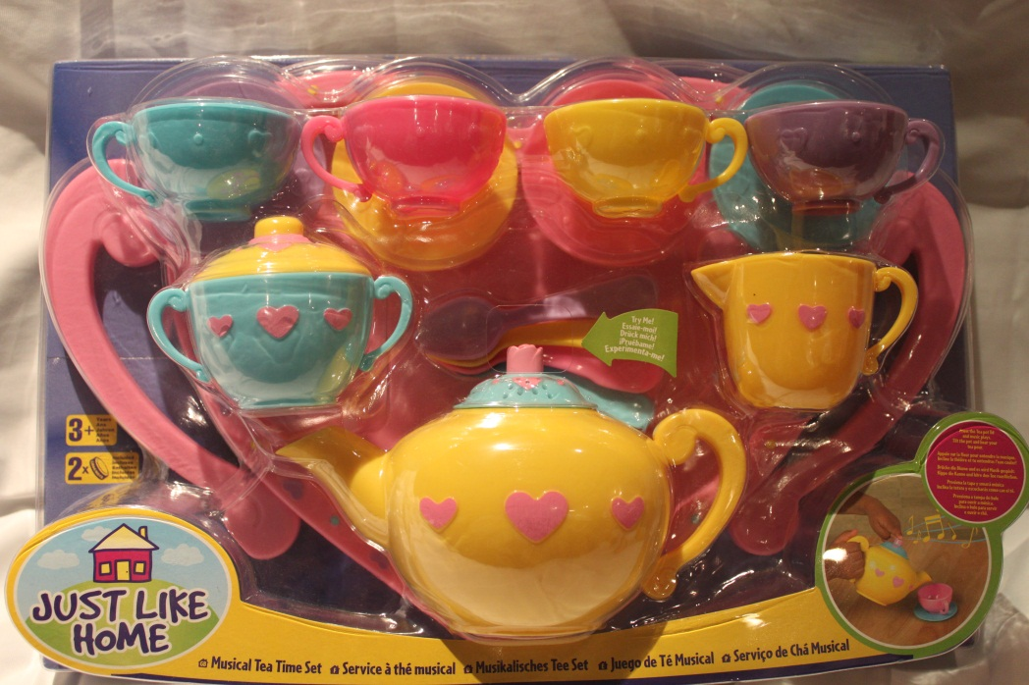
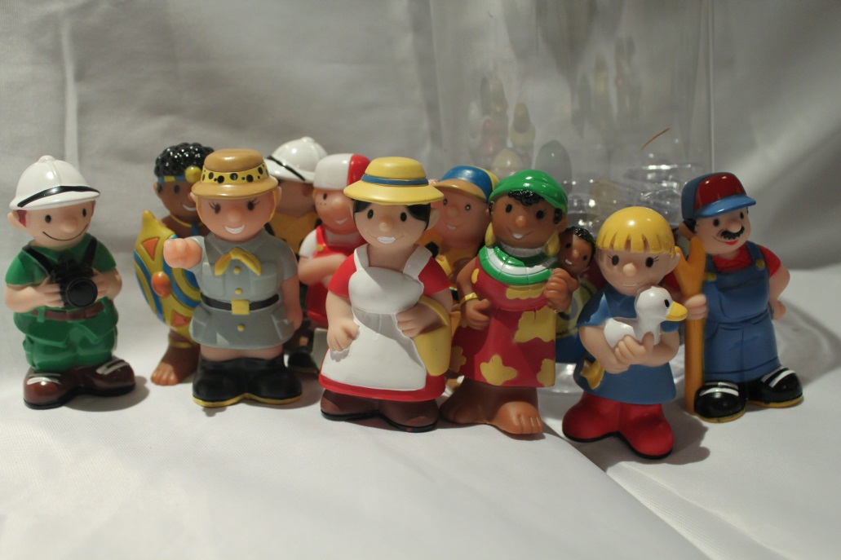
NPS-K9
Just Like Home
Musical Tea Time Set
Contains – Tray, 4 cups, 4 saucers, 4 teaspoons, creamer, sugar bowl and Teapot.
Ages 3+ (contains batteries)
NPS-K9
NPS-K10
Bruin People
Contains – 10 figures
Ages – 2-5
NPS – K10
Naidovi Primary School – Kindergarten – July 2012

Slide 7
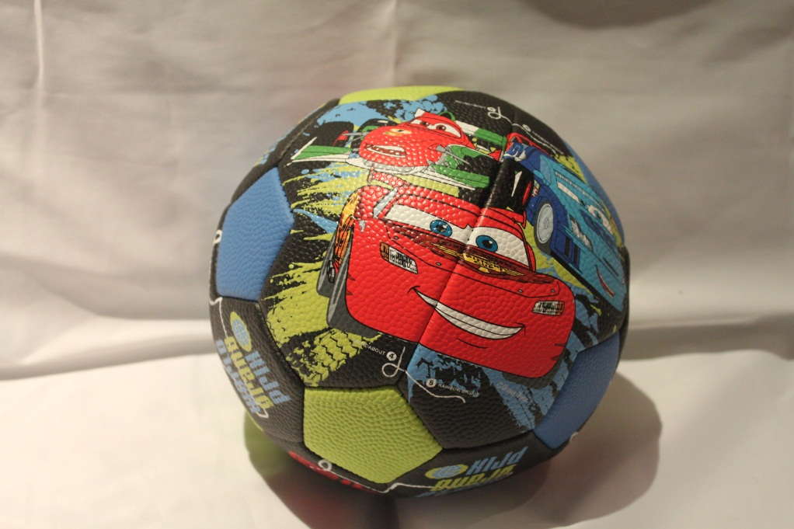
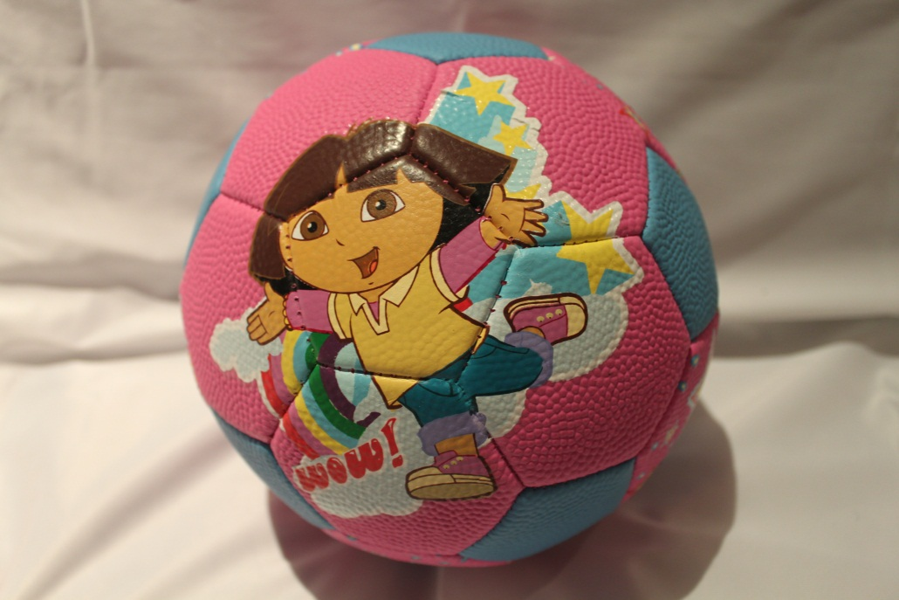
NPS-K11
Nickelodeon Jnr.
CARS
Soccer Ball
Contains – 1 ball
NPS-K11
NPS-K12
Nickelodeon Jnr.
Dora the Explorer
Soccer Ball
Contains – 1 ball
NPS-K12
Naidovi Primary School – Kindergarten – July 2012

Slide 8
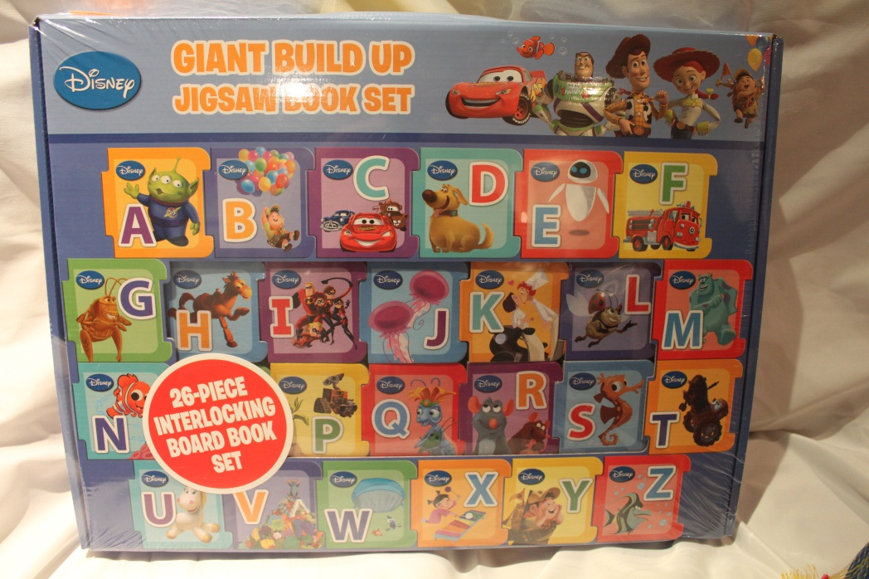
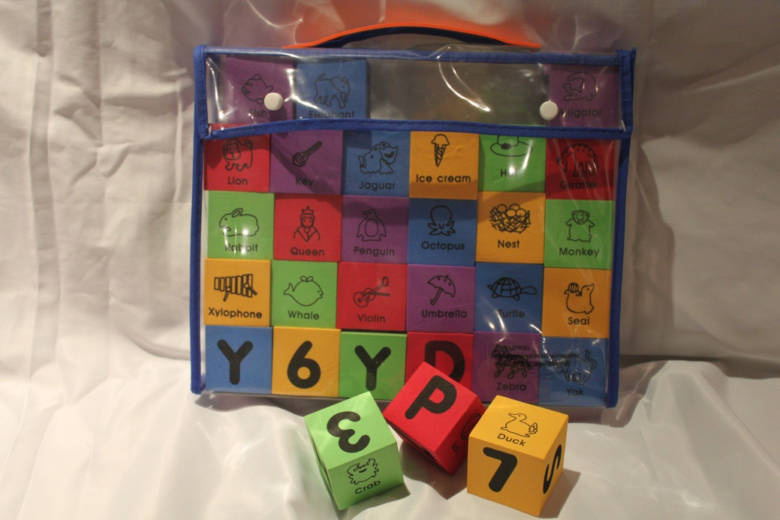
NPS-K13
Disney
Giant Build Up Jigsaw Book Set
26 piece interlocking board book set
Contains – 26 peices
NPS-K13
NPS-K14
Imaginarium
Alphabet & Numbers Foam Building Blocks
Contains – 30 blocks, bag
Ages – 2+
NPS-K14
Naidovi Primary School – Kindergarten – July 2012

Slide 9
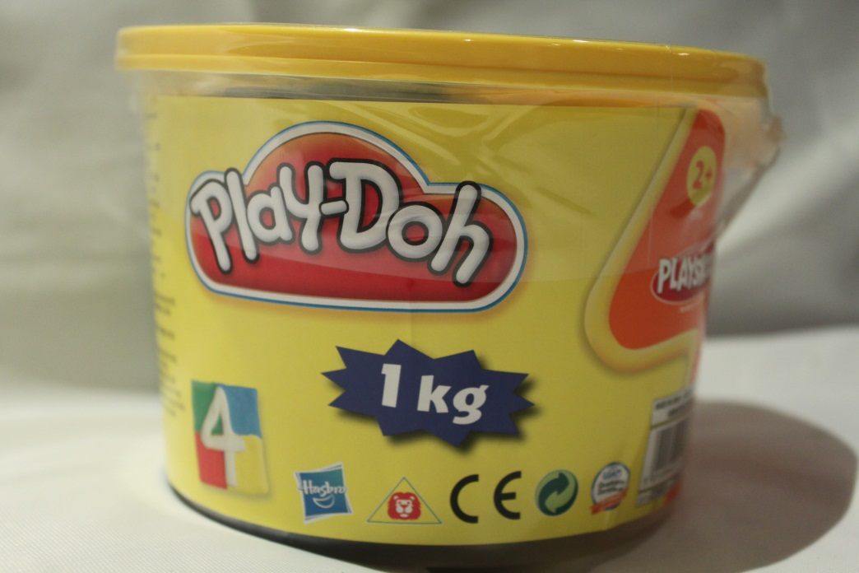
NPS-K14
NPS-K15
Play-Doh
1kg
Contains – 4 colours
Ages – 2+
WARNING - NOT TO BE EATEN
NPS-K15
NPS-K16
Play-Doh
1kg
Contains – 4 colours
Ages – 2+
WARNING - NOT TO BE EATEN
NPS-K16
Naidovi Primary School – Kindergarten – July 2012

Slide 10
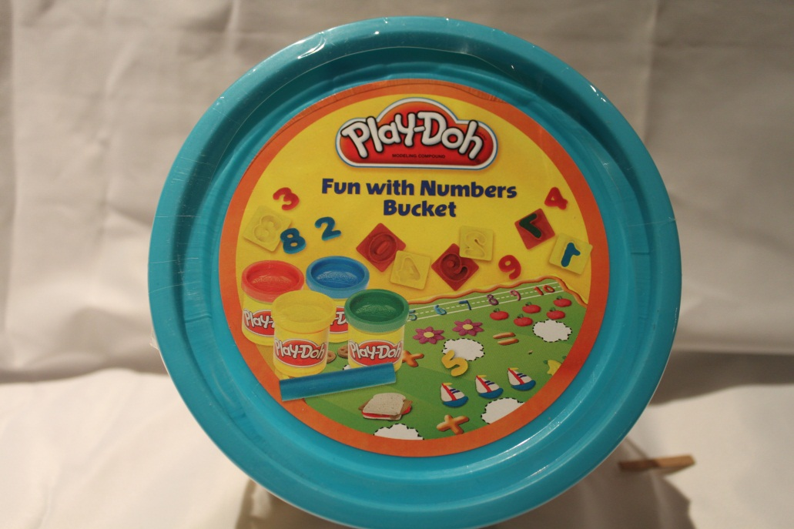
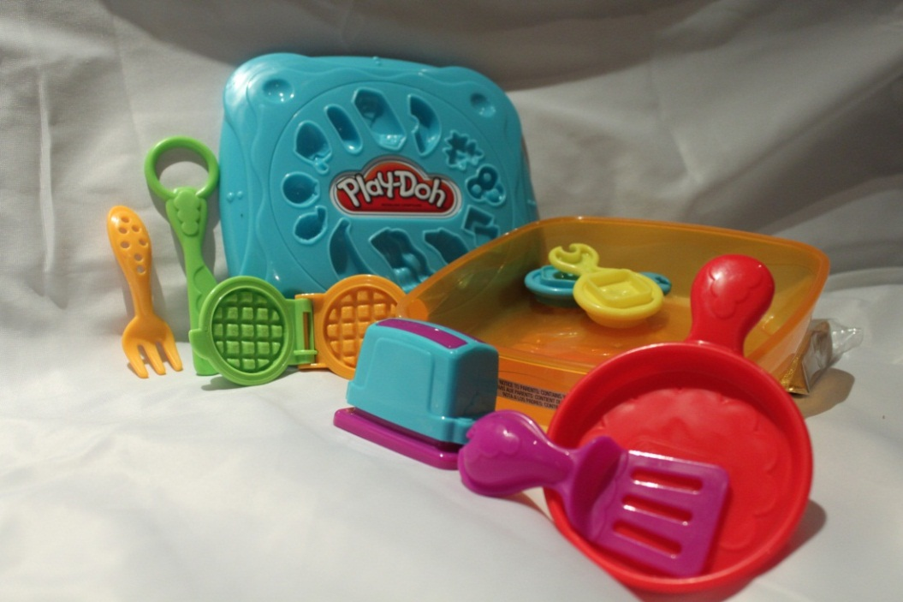
NPS-K17
Play-Doh
Fun with Numbers Bucket
Contains – 10 number cutters, roller, playmat, 4 cans play doh.
Ages -3+
DO NOT EAT PLAY-DOH
NPS-K17
NPS-K18
Play-Doh
Breakfast Set
Contains – Container & lid with moulds, toaster (2 pieces), waffle iron, plastic knife with ring, pan, 2 moulds, spatula, fork, playmat & 4 bars of Play-Doh
Ages – 3+
DO NOT EAT PLAY-DOH
NPS-K18
Naidovi Primary School – Kindergarten – July 2012

Slide 11
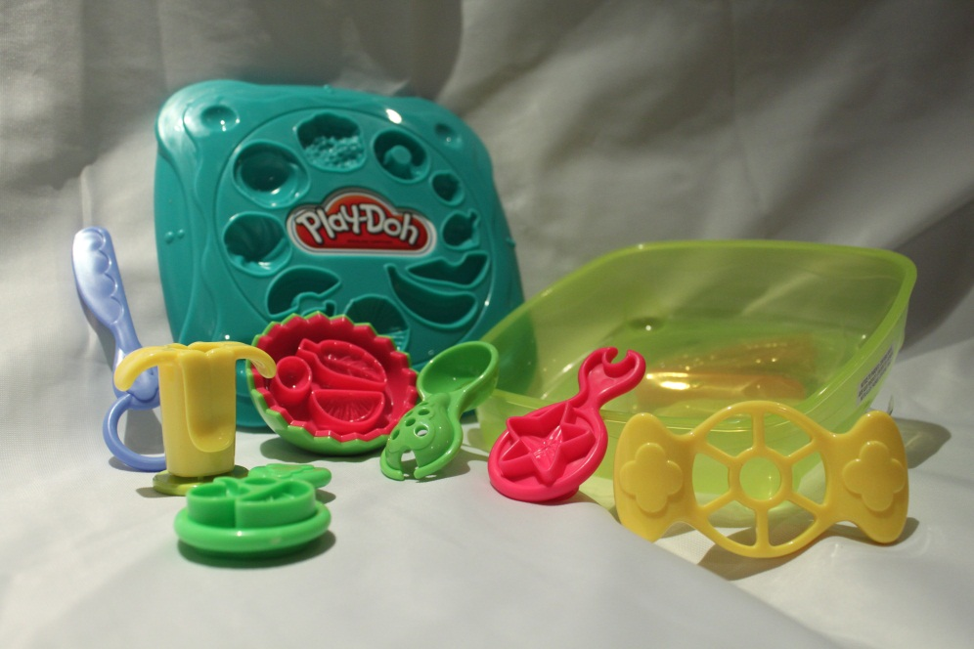
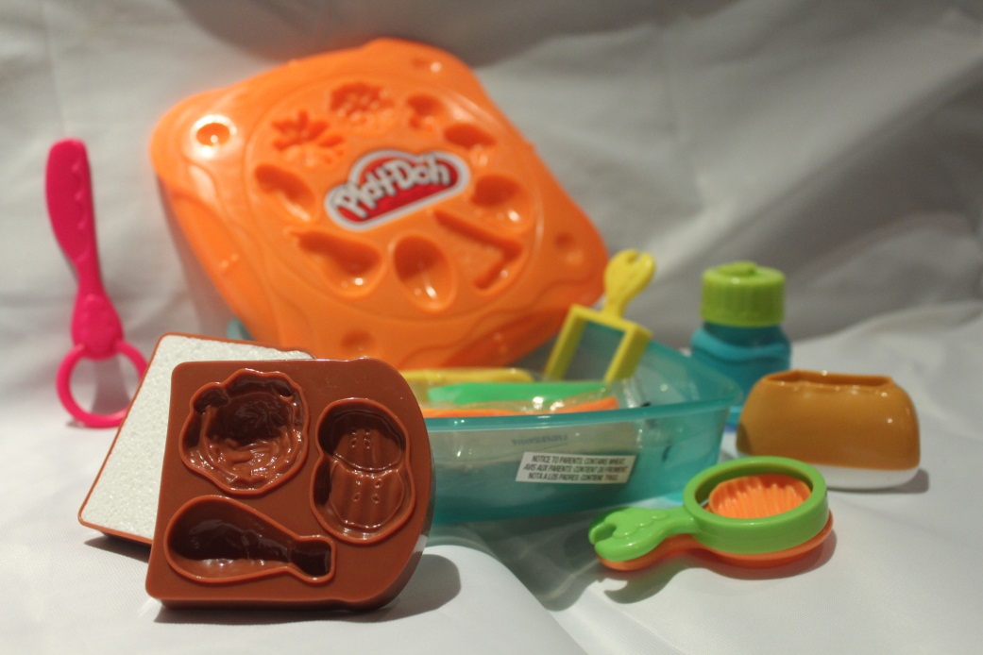
NPS-K19
Play-Doh
Sandwich Shop
Contains – Container & lid with molds, 2 bread slices, roll, 3 moulds, juice bottle presser, knife with ring, playmat & 4 bars of Play-Doh
Ages – 3+
DO NOT EAT PLAY-DOH
NPS-K19
NPS-K20
Play-doh
Fabulous Fruits
Contains – Container & lid with moulds, watermelon bowl, banana presser, scooper, knife with ring, apple slicer, playmat 3 molds and 4x bars of Play Doh
Ages – 3+
DO NOT EAT PLAY-DOH
NPS-K20
Naidovi Primary School – Kindergarten – July 2012

Slide 12
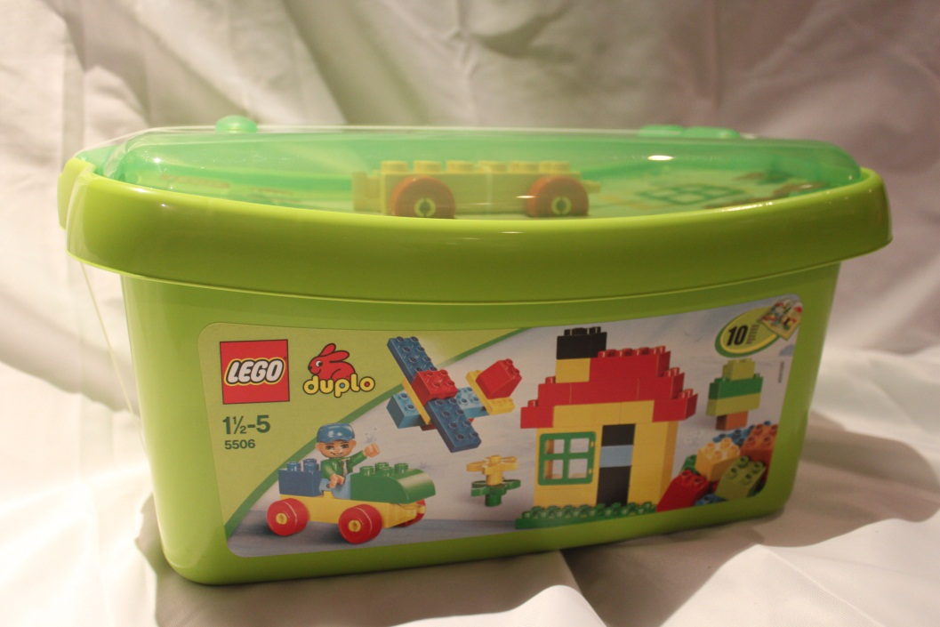
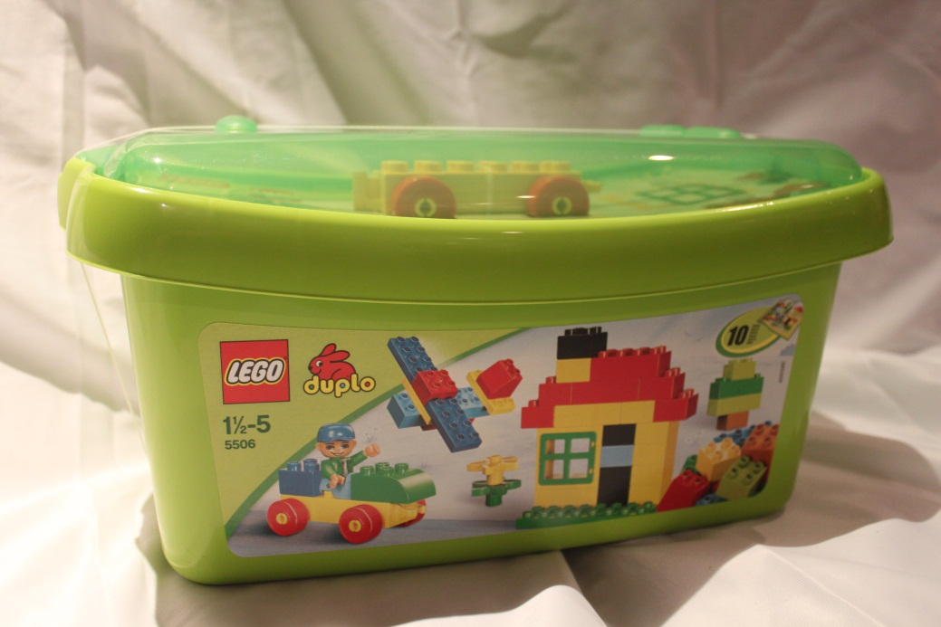
NPS-K21
Lego Duplo 5506
Fine Motor Skills
Ideas & Creativity
Shapes & Colours
Contains – Container, 70 blocks, 1 figure.
Ages – 1 ½ - 5
NPS-K22
Lego Duplo 5506
Fine Motor Skills
Ideas & Creativity
Shapes & Colours
Contains – Container, 70 blocks, 1 figure.
Ages – 1 ½ - 5
NPS-K21
NPS-K22
Lego Duplo 5506
Fine Motor Skills
Ideas & Creativity
Shapes & Colours
Contains – Container, 70 blocks, 1 figure.
Ages – 1 ½ - 5
NPS-K22
Naidovi Primary School – Kindergarten – July 2012

Slide 13
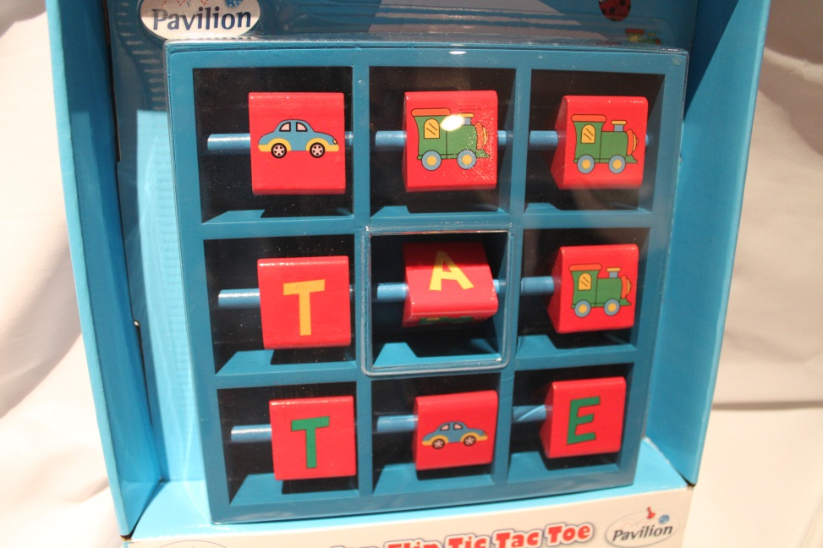
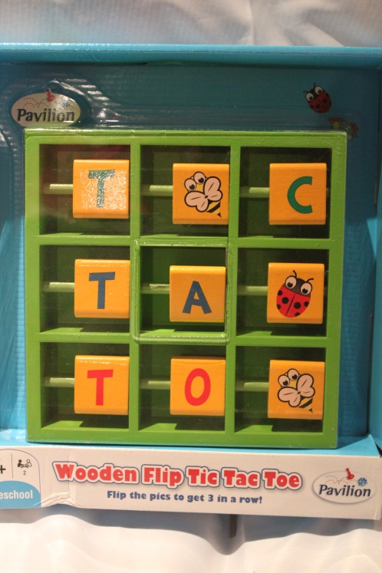
NPS-K23
Pavillion
Wooden Flip Tic Tac Toe
Flip the pieces to get 3 in a row.
Contains – 1 piece (red and blue)
Ages – 3+
NPS-K23
NPS-K24
Pavillion
Wooden Flip Tic Tac Toe
Flip the pieces to get 3 in a row.
Contains – 1 piece (yellow and green)
Ages – 3 +
NPS-K24
Naidovi Primary School – Kindergarten – July 2012

Slide 14
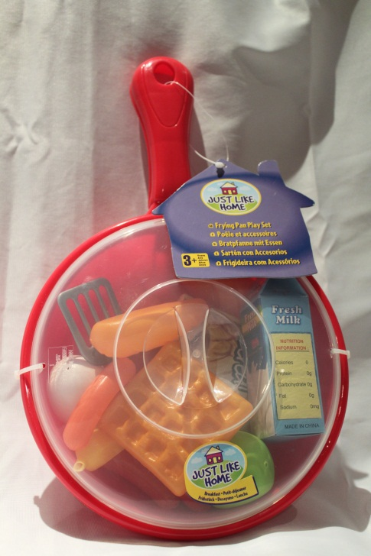
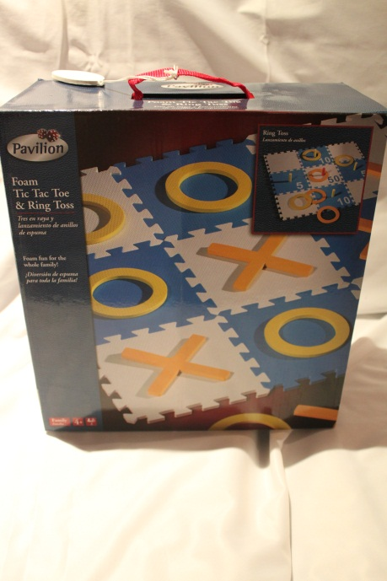
NPS-K25
Just Like Home
Breakfast Set
Contains – Frypan, assorted plastic food, cardboard cartons, egg flip
Ages – 3+
NPS-K25
NPS-K26
Foam Tic Tac Toe & Ring Toss
Contains – 9 piece interlocking game surface, 5 orange “x”, 5 yellow “O”, 3 orange “O”, 5 pegs for ring toss, Game instructions.
Ages – 4+
NPS-K26
Naidovi Primary School – Kindergarten – July 2012

Slide 15
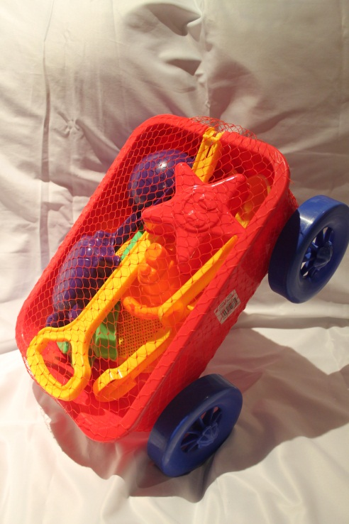
NPS-K27
Sand & Water Play Wagon
Contains – 1 wagon (red and blue), 9 pieces
Ages – 2+
NPS-K27
NPS-K28
NPS-K28
Sand & Waterplay Wagon
Contains – 1 wagon (red and blue), 9 pieces
Ages – 2+

Slide 16
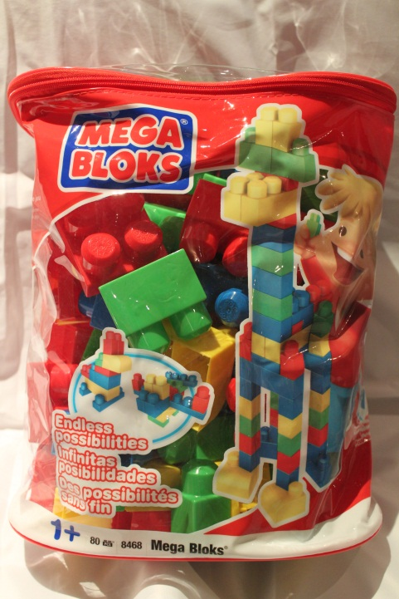
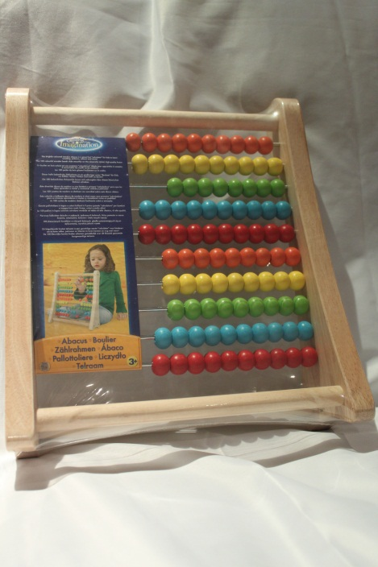
NPS-K29
Mega Blocks
Building Blocks
Contains – Bag, 80 blocks.
Ages – 1+
NPS-K29
NPS-K30
Universe of Imagination
Abacus – The brightly coloured wooden abacus is a great first calculator for kids to learn counting, patterns, colours and more.
Contains – 1 piece
Ages – 3+
NPS-K30

Slide 17
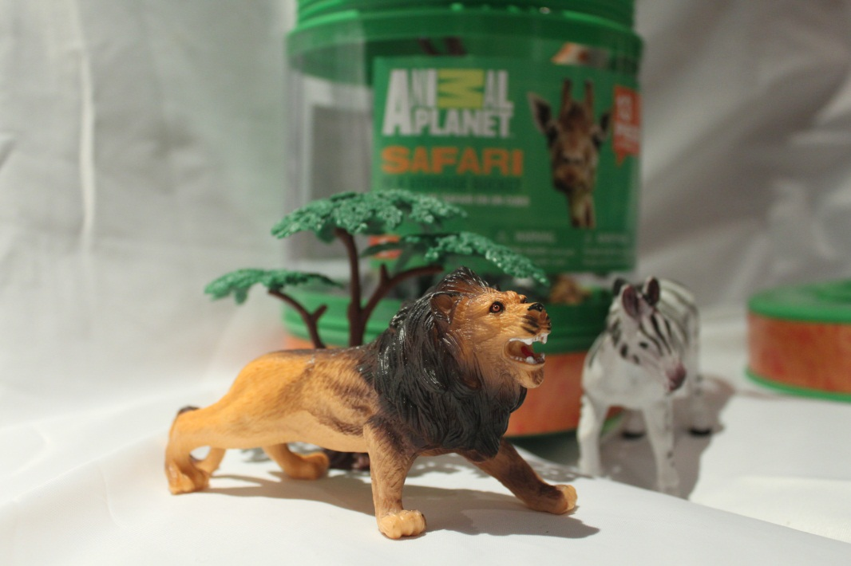
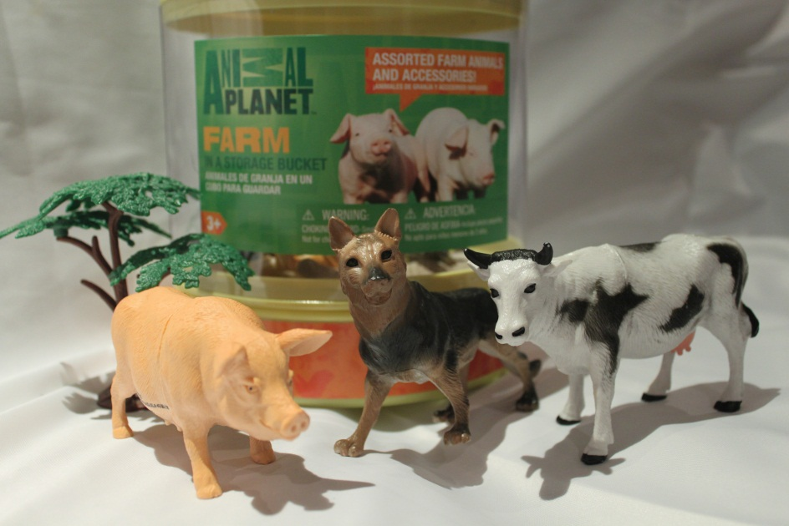
NPS-K31
Animal Planet Safari
Contains Bucket, 13 pieces
Ages – 3+
NPS-K31
NPS-K32
Animal Planet Farm
Contains Bucket, 14 pieces
Ages – 3+
NPS-K32
Naidovi Primary School – Kindergarten – July 2012

Slide 18
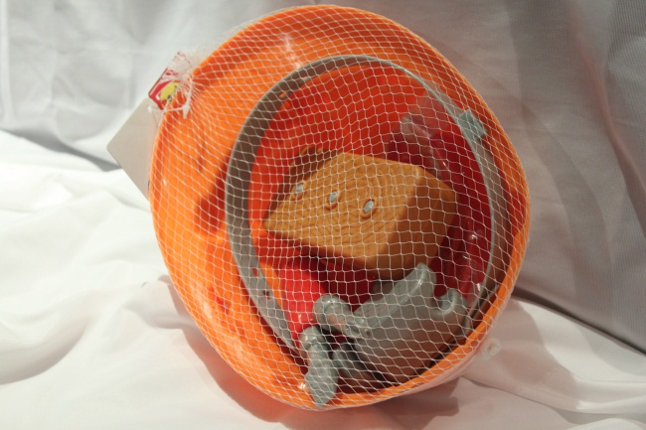
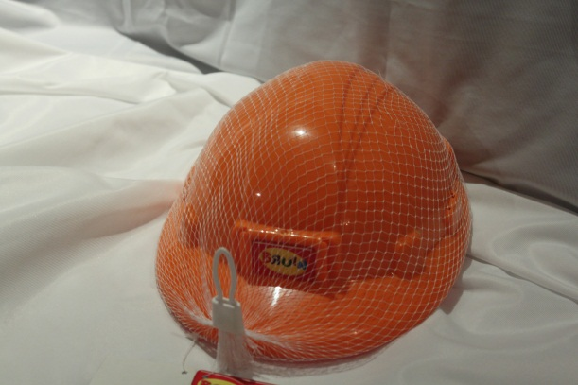
NPS-K33
Brauin Helmet & tool Set
Contents - Hard hat, head protector, plastic wood, 3 screws, hammer, screwdriver, Goggles, Drill bit,
Age – 2+
NPS-k33
NPS-K34
Brauin Helmet & tool Set
Contents - Hard hat, head protector, plastic wood, 3 screws, hammer, screwdriver, Goggles, Drill bit,
Age – 2+
NPS-K34
Naidovi Primary School – Kindergarten – July 2012

Slide 19
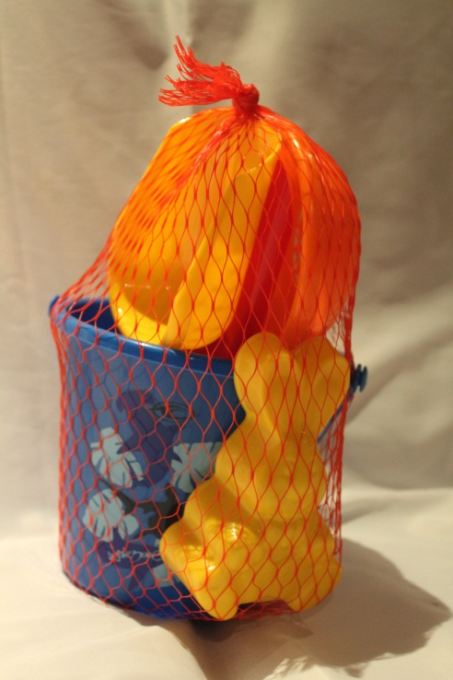
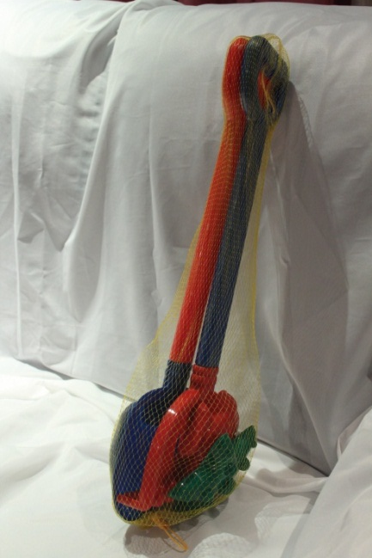
NPS-K35
Bucket and Sand Set
Contents – Bucket, shovel, fork, sieve, mould
Ages – 2+
NPS-K35
NPS-K36
Sand Set
Contents – Spade, rake, 2 moulds
Ages – 2+
2 copies
NPS-K36
Naidovi Primary School – Kindergarten – July 2012

Slide 20
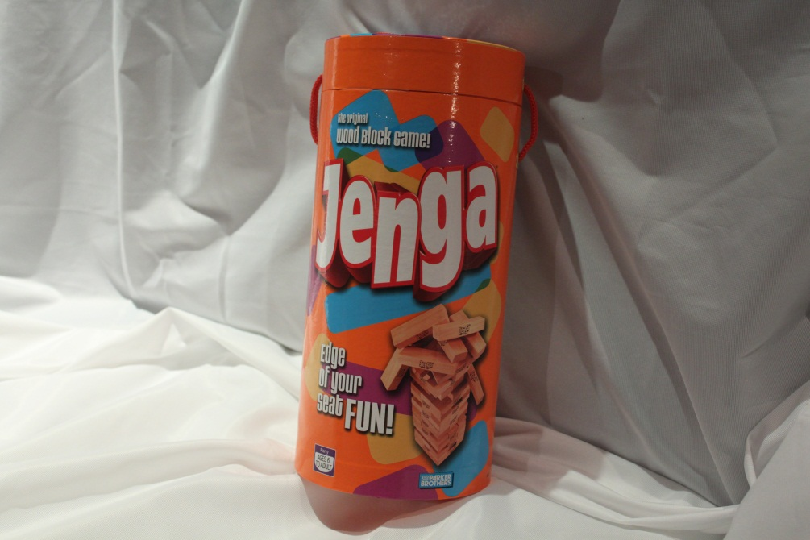
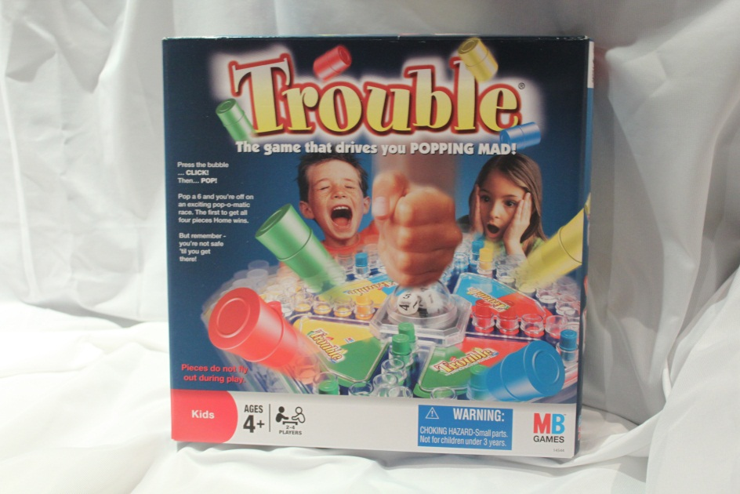
NPS-K37
Jenga
Take turns in pulling a block out without letting them all fall
Contains – Box, blocks
Ages 5 to adult
NPS-K37
NPS-K38
Trouble
Can you get around the board quicker than your opponents.
Contains – Box, Game
Ages 4 to adult
NPS-K38

Slide 21
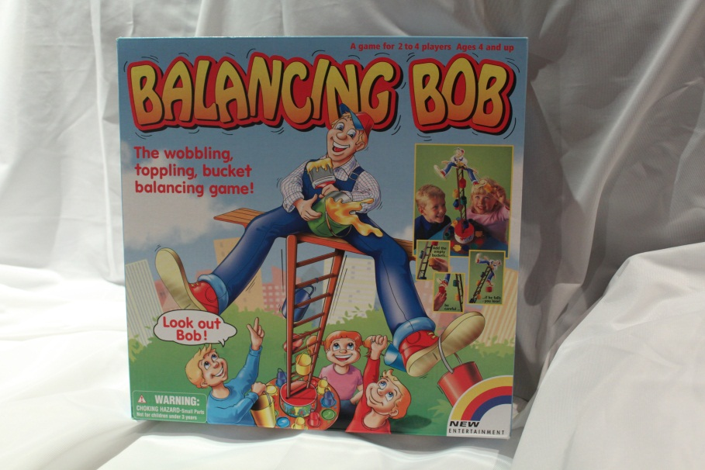
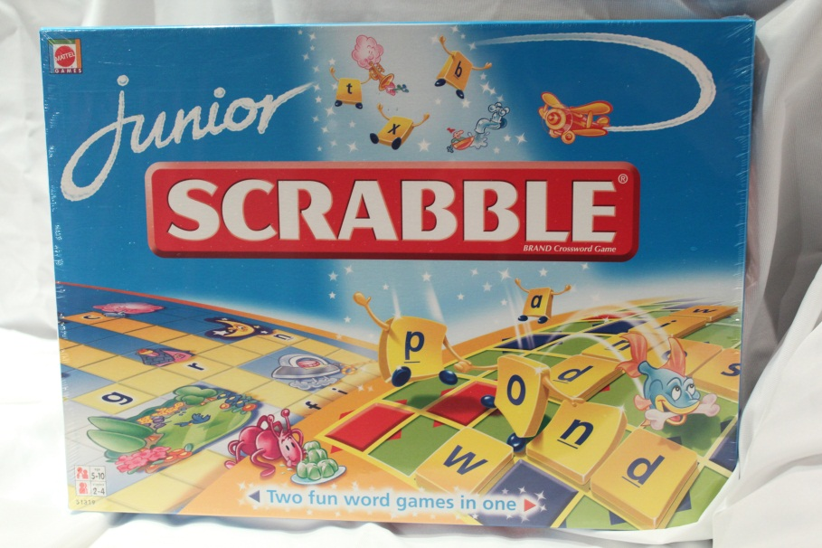
NPS-K39
Balancing Bob
NPS-K39
NPS-K40
Junior Scrabble
Word game
Contains – box, game board, letter tiles, instructions
Ages 6+
NPS-K40

Slide 22
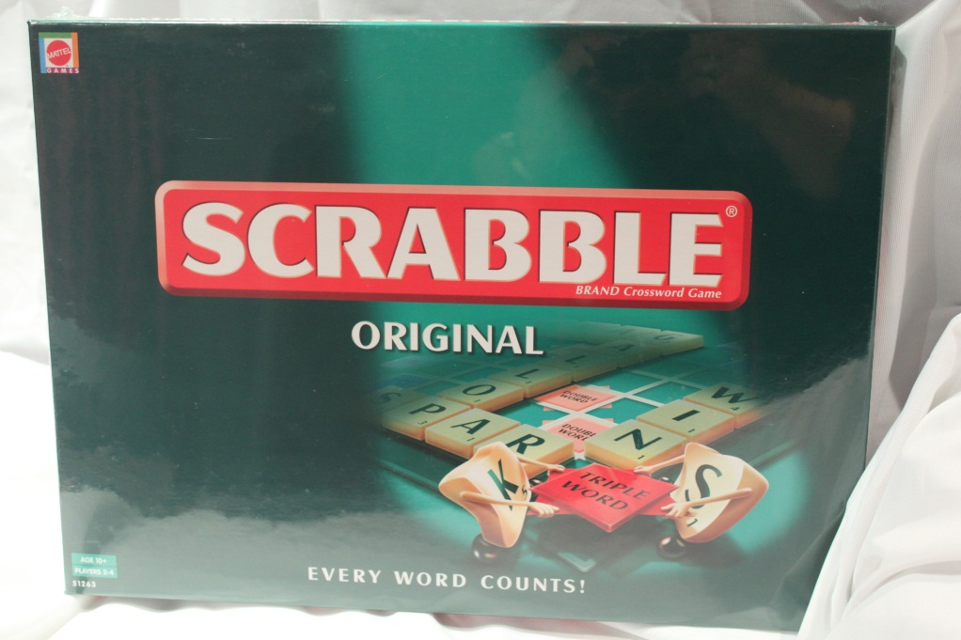
NPS-K41
Scrabble Original
Word game
Contains – box, game board, tiles, instructions
Ages – 5 to adult
NPS-K41
NPS-K42
Scrabble Original
Word Game
Contains – box, game board, tiles instructions
Ages – 5 to adult
NPS-K42
Naidovi Primary School – Kindergarten – July 2012

Slide 23
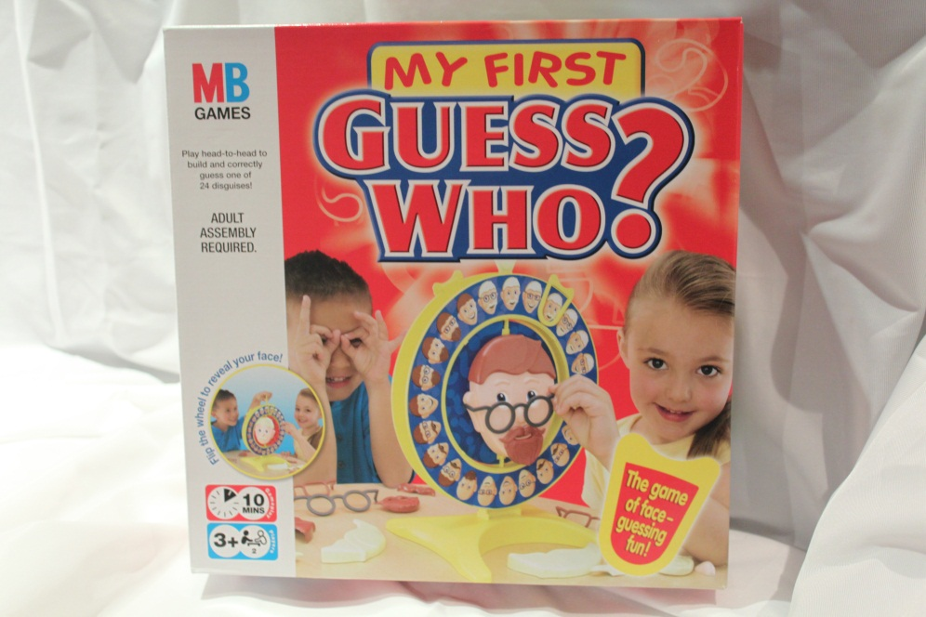
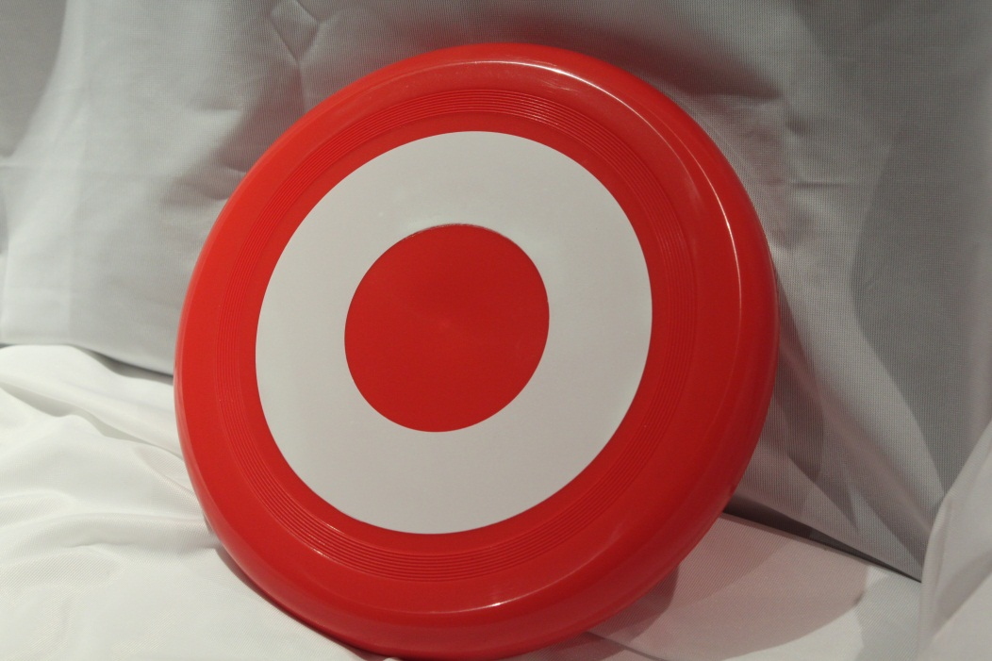
NPS-K43
My First Guess Who?
Guess who by eliminating suspects by description
Contains. Board game and pieces
Ages – 3 +
NPS-K43
NPS-K44
Frisbee
Throw and catch the Frisbee – 1 or more people game
Contains – 1 Frisbee
Ages – 4 to adult
NPS-K44
Naidovi Primary School – Kindergarten – July 2012

Slide 24
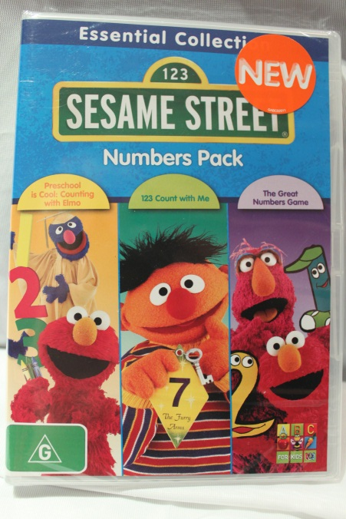
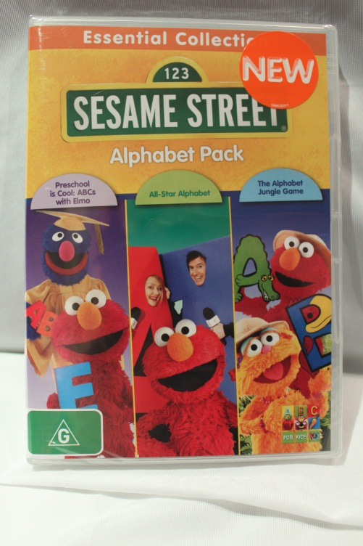
NPS-K45
ABC Learning
Sesame Street CD
Numbers Pack (G rating)
Contains - CD, Case
Ages – 2+
NPS-K45
NPS-K46
ABC Learning
Sesame Street CD
Alphabet Pack (G rating)
Contains – CD, Case
Ages – 2+
NPS-K46
Naidovi Primary School – Kindergarten – July 2012

Slide 25
NPS-K47
Frisbee
Throw and catch the Frisbee – 1 or more people game
Contains – 1 Frisbee
Ages – 4 to adult
NPS-K47
NPS-K48
Frisbee
Throw and catch the Frisbee – 1 or more people game
Contains – 1 Frisbee
Ages – 4 to adult
NPS-K48
Naidovi Primary School – Kindergarten – July 2012

Slide 26
NPS-K49
Frisbee
Throw and catch the Frisbee – 1 or more people
Contains – 1 Frisbee
Ages – 4 to adult
NPS-K49
NPS-K50
Frisbee
Throw and catch the Frisbee – 1 or more people
Contains – 1 Frisbee
Ages – 4 to adult
NPS-K50
Naidovi Primary School – Kindergarten – July 2012

Slide 27
NPS-K51
Frisbee
Throw and catch the Frisbee – 1 or more people
Contains – 1 Frisbee
Ages – 4 to adult
NPS-K51
NPS-K52
Frisbee
Throw and catch the Frisbee – 1 or more people
Contains – 1 Frisbee
Ages – 4 to adult
NPS-K52
Naidovi Primary School – Kindergarten – July 2012

Slide 28
Books
Children’s picture book – 15 titles mainly board books
Books
Children’s big pictures books – 5 titles
Naidovi Primary School – Kindergarten – July 2012

